Slide 1
Chapter 6 Basic SQL

Slide 2
Content
SQL Data Definition and Data Types
Specifying Constraints in SQL
Basic Retrieval Queries in SQL
INSERT, DELETE, and UPDATE Statements in SQL
Additional features in SQL

Slide 3
Introduction about SQL
SQL: Structured Query Language.
Originally, SQL was called SEQUEL (Structured English QUEry Language) and was designed and implemented at IBM Research as the interface for an experimental relational database system called SYSTEM R.
SQL is now the standard language for commercial relational DBMSs.
SQL is a comprehensive database language: It has statements for data definitions, queries, and updates. Hence, it is both a DDL and a DML.
It has facilities for:
Defining views on the database,
specifying security and authorization,
defining integrity constraints, and
specifying transaction controls.

Slide 4
SQL Data Definition and Data Types
SQL uses the terms table, row, and column for the formal relational model terms relation, tuple, and attribute.
The main SQL command for data definition is the CREATE statement, which can be used to
create schemas,
tables (relations),
domains,
views,
assertions,
and triggers.

Slide 5
SQL Data Definition and Data Types
Schema and Catalog Concepts in SQL
An SQL schema is identified by a schema name and includes an authorization identifier to indicate the user or account who owns the schema, as well as descriptors for each element in the schema.
Schema elements include tables, constraints, views, domains, and other constructs (such as authorization grants) that describe the schema.
A schema is created via the CREATE SCHEMA statement, which can include all the schema elements’ definitions.
For example, the following statement creates a schema called “COMPANY” owned by the user with authorization identifier ‘Jsmith’.
CREATE SCHEMA COMPANY AUTHORIZATION ‘Jsmith’;
In general, all users are not allowed to create schemas. This privilege is grant by system Admin or the DBA

Slide 6
SQL Data Definition and Data Types
Schema and Catalog Concepts in SQL
In addition to the concept of a schema, SQL uses the concept of a catalog—a named collection of schemas.
A catalog always contains a special schema called INFORMATION_SCHEMA, which provides information on all the schemas in the catalog and all the element descriptors in these schemas.
Integrity constraints such as referential integrity can be defined between relations only if they exist in schemas within the same catalog.

Slide 7
SQL Data Definition and Data Types
The CREATE TABLE Command in SQL
The CREATE TABLE command is used to specify a new relation by giving it a name and specifying its attributes and initial constraints.
The attributes are specified first, and each attribute is given a name, a data type to specify its domain of values, and possibly attribute constraints, such as NOT NULL.
The key, entity integrity, and referential integrity constraints can be specified within the CREATE TABLE statement after the attributes are declared, or they can be added later using the ALTER TABLE command.
Figure 6.1 in the next slide shows sample data definition statements in SQL for the COMPANY relational database schema.

Slide 8
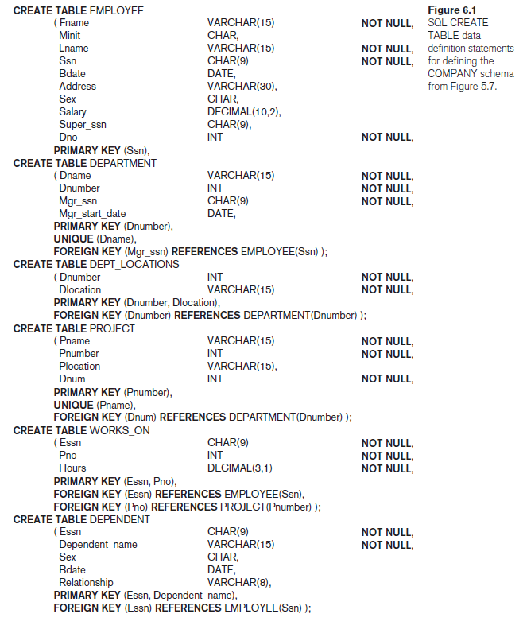

Slide 9
SQL Data Definition and Data Types
The CREATE TABLE Command in SQL
The relations declared through CREATE TABLE statements are called base tables (or base relations) this means that the table and its rows are actually created and stored as a file by the DBMS.
Base relations are distinguished from virtual relations, created through the CREATE VIEW statement, which may or may not correspond to an actual physical file.
In SQL, the attributes in a base table are considered to be ordered in the sequence in which they are specified in the CREATE TABLE statement. However, rows (tuples) are not considered to be ordered within a table (relation).
It is important to note that in Figure 6.1, there are some foreign keys that may cause errors because they are specified either via circular references(self join) or because they refer to a table that has not yet been created.

Slide 10
SQL Data Definition and Data Types
The CREATE TABLE Command in SQL
To deal with this type of problem, these constraints can be left out of the initial CREATE TABLE statement, and then added later using the ALTER TABLE statement.
For example, the foreign key Super_ssn in the EMPLOYEE table is a circular reference because it refers to the EMPLOYEE table itself. The foreign key Dno in the EMPLOYEE table refers to the DEPARTMENT table, which has not been created yet.
We create dept table first then add its FK to Employee table using ALTER TABLE command.

Slide 11
SQL Data Definition and Data Types
Attribute Data Types and Domains in SQL
The basic data types available for attributes include numeric, character string, bit string, Boolean, date, and time.
Numeric data types include integer numbers of various sizes (INTEGER or INT, and SMALLINT) and floating-point (real) numbers of various precision (FLOAT or REAL, and DOUBLE PRECISION). Formatted numbers can be declared by using DECIMAL(i, j)—or DEC(i, j) where i, the precision, is the total number of decimal digits and j, the scale, is the number of digits after the decimal point.
Character-string data types are either fixed length—CHAR(n) or CHARACTER(n), where n is the number of characters—or varying length— VARCHAR(n) or CHAR VARYING(n) or CHARACTER VARYING(n), where n is the maximum number of characters. Another datatype CLOB (Character Large Object) can hold larger text values like in kilobytes, mega bytes of Gigabytes.
E.g., CLOB (20M)
Bit-string data types are either of fixed length n—BIT(n)—or varying length— BIT VARYING(n), where n is the maximum number of bits. The default for n, the length of a character string or bit string, is 1. used to hold data like 1010101011.

Slide 12
SQL Data Definition and Data Types
Attribute Data Types and Domains in SQL
The basic data types available for attributes include numeric, character string, bit string, Boolean, date, and time.
A Boolean data type has the traditional values of TRUE or FALSE. In SQL, because of the presence of NULL values, a three-valued logic is used, so a third possible value for a Boolean data type is UNKNOWN.
The DATE data type has ten positions, and its components are YEAR, MONTH, and DAY in the form YYYY-MM-DD. The TIME data type has at least eight positions, with the components HOUR, MINUTE, and SECOND in the form HH:MM:SS.
A timestamp data type (TIMESTAMP) includes the DATE and TIME fields, plus a minimum of six positions for decimal fractions of seconds and an optional WITH TIME ZONE qualifier.
We can specify daatypes as in figure 6.1 bbut alternatively a Domain can be declared, and the domain name can be used with the attribute specification.
For example, we can create a domain SSN_TYPE by the following statement:
CREATE DOMAIN SSN_TYPE AS CHAR(9);

Slide 13
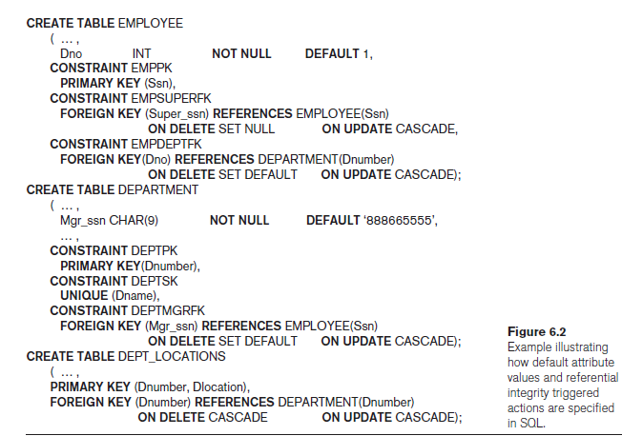
Specifying Constraints in SQL
Specifying Attribute Constraints and Attribute Defaults
Since SQL allows NULLs as attribute values, so a constraint NOT NULL may be specified if NULL is not permitted for a particular attribute.
It is also possible to define a default value for an attribute by appending the clause DEFAULT <value> to an attribute definition. The default value is included in any new tuple if an explicit value is not provided for that attribute.
Figure 6.2 illustrates an example of specifying a default manager for a new department and a default department for a new employee.
If no default clause is specified, the default value is NULL for attributes that do not have the NOT NULL constraint.

Slide 14
Specifying Constraints in SQL
Specifying Attribute Constraints and Attribute Defaults
Another type of constraint can restrict attribute or domain values using the CHECK clause following an attribute or domain definition.
For example, suppose that department numbers are restricted to integer numbers between 1 and 20; then, we can change the attribute declaration of Dnumber in the DEPARTMENT table.
Dnumber INT NOT NULL CHECK (Dnumber > 0 AND Dnumber < 21);
The CHECK clause can also be used in conjunction with the CREATE DOMAIN statement.
For example, we can write the following statement:
CREATE DOMAIN D_NUM AS INTEGER CHECK (D_NUM > 0 AND D_NUM < 21);
Now, we can use this domain as attribute type in multiple relations where Dnum is used.

Slide 15
Specifying Constraints in SQL
Specifying Key and Referential Integrity Constraints
PRIMARY KEY clause:
specifies one or more attributes that make up the primary key of a relation.
If a primary key has a single attribute, the clause can follow the attribute directly.
For example, the primary key of DEPARTMENT can be specified as follows:
Dnumber INT PRIMARY KEY
UNIQUE Clause:
specifies alternate (unique) keys, also known as candidate keys.
can also be specified directly for a unique key if it is a single attribute, as in the following example:
Dname VARCHAR(15) UNIQUE

Slide 16
Specifying Constraints in SQL
Specifying Key and Referential Integrity Constraints
FOREIGN KEY clause:
Referential integrity can be maintained using foreign key clause
That clause can be violated during insertion, deletion or updating.
So an instant action is required to deal with the violations
SQL by default uses the RESTRICT clause that rejects the operations in case of violation.
But Schema designer can specify an alternative action to be taken by attaching a referential triggered action clause to any foreign key constraint.
The options include SET NULL, CASCADE, and SET DEFAULT. An option must be qualified with either ON DELETE or ON UPDATE

Slide 17
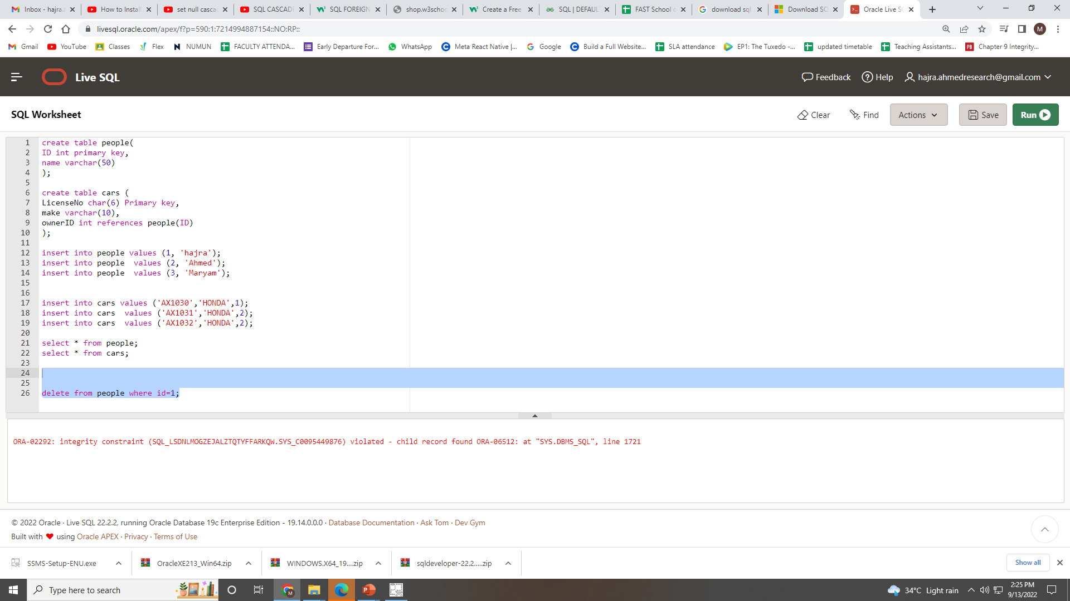

Slide 18
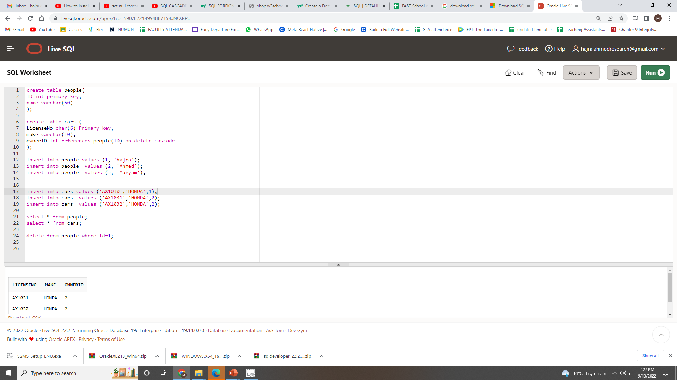

Slide 19
Specifying Constraints in SQL
Specifying Key and Referential Integrity Constraints
FOREIGN KEY clause:
The options include SET NULL, CASCADE, and SET DEFAULT. An option must be qualified with either ON DELETE or ON UPDATE
Consider the following schema:
People(id, name )
Cars(licenceNo, model, make, ownerID)
Here we can imply the FK as :
ownerID int references people(id) on delete set default
ownerID int references people(id) on delete cascade
ownerID int references people(id) on delete no action

Slide 20
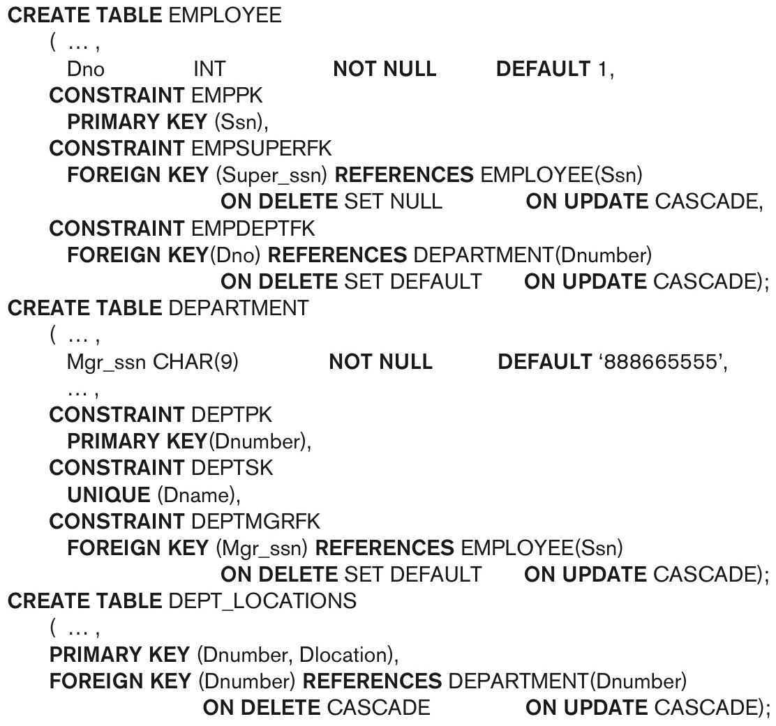
Specifying Constraints in SQL
Giving Names to Constraints
A constraint may be given a constraint name, following the keyword CONSTRAINT.
The names of all constraints within a particular schema must be unique.
A constraint name is used to identify a particular constraint in case the constraint must be dropped later and replaced with another constraint.

Slide 21
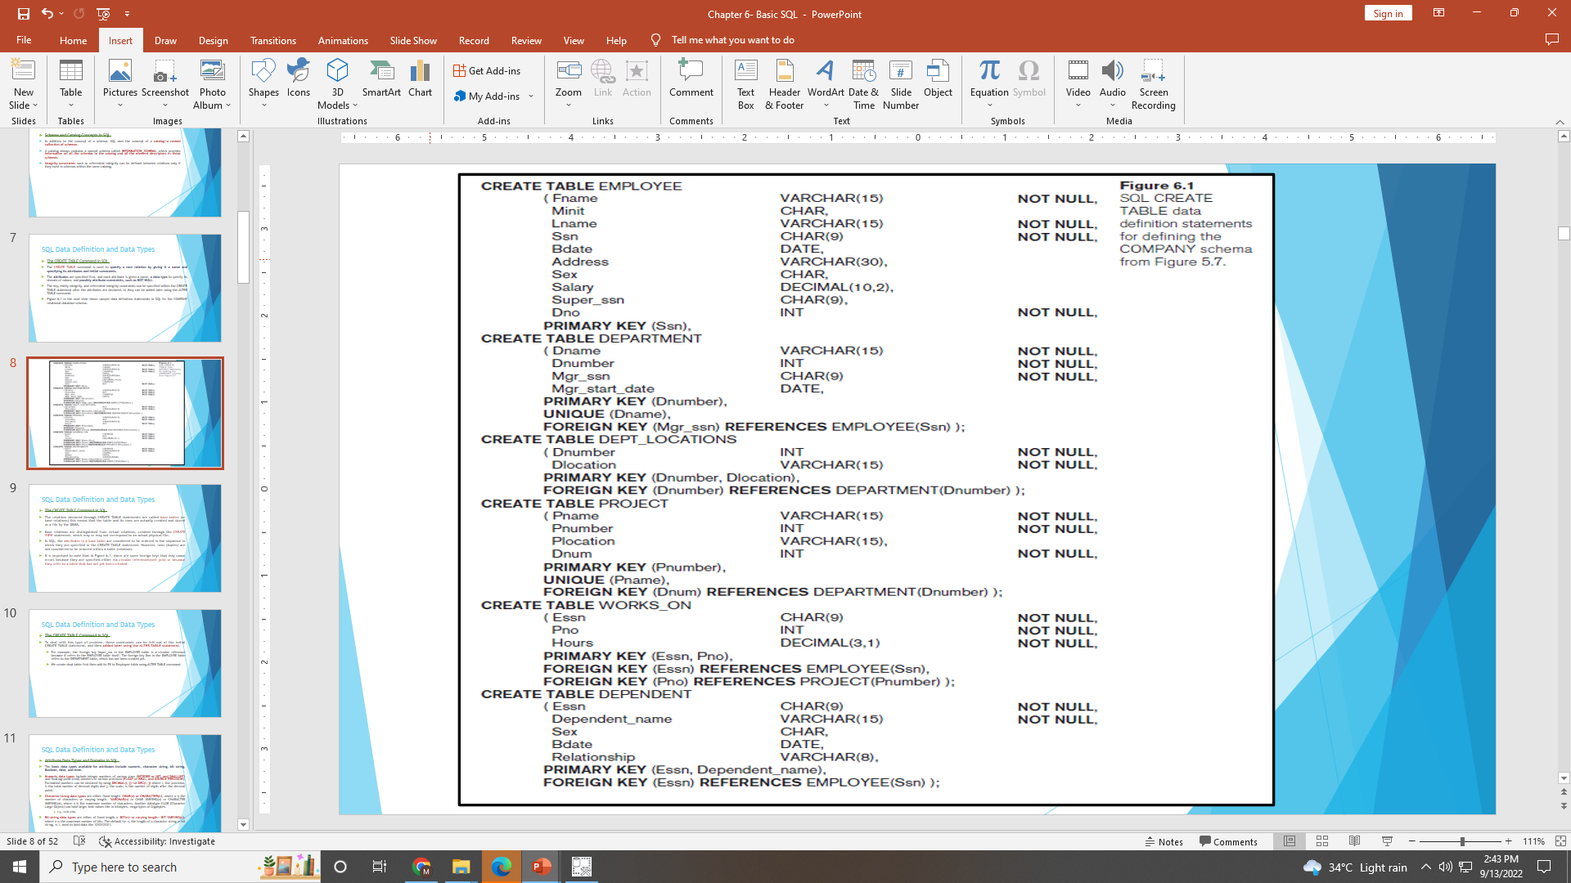
Specifying Constraints in SQL
Specifying Constraints on Tuples Using CHECK
Table constraints can be specified through additional CHECK clauses at the end of a CREATE TABLE statement.
These can be called row-based constraints because they apply to each row individually and are checked whenever a row is inserted or modified.
For example, suppose that the DEPARTMENT table in Figure 6.1 had an additional attribute Dept_create_date, which stores the date when the department was created.
Then we could add the following CHECK clause at the end of the CREATE TABLE statement for the DEPARTMENT table to make sure that a manager’s start date is later than the department creation date.
CHECK (Dept_create_date <= Mgr_start_date);

Slide 22
Basic Retrieval Queries in SQL
The SELECT-FROM-WHERE Structure of Basic SQL Queries
The basic form of the SELECT statement, sometimes called a mapping or a select-from-where block, is formed of the three clauses SELECT, FROM, and WHERE and has the following form:
SELECT <attribute list>
FROM <table list>
WHERE <condition>;
where
<attribute list> is a list of attribute names whose values are to be retrieved by the query.
<table list> is a list of the relation names required to process the query.
<condition> is a conditional (Boolean) expression that identifies the tuples to be retrieved by the query.

Slide 23
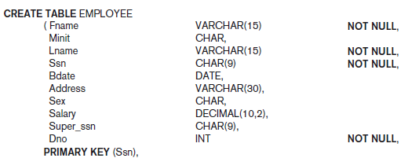

Basic Retrieval Queries in SQL
The SELECT-FROM-WHERE Structure of Basic SQL Queries
Query 0. Retrieve the birth date and address of the employee(s) whose name is ‘John B. Smith’.
Q0: SELECT Bdate, Address
FROM EMPLOYEE
WHERE Fname = ‘John’ AND Minit = ‘B’ AND Lname = ‘Smith’;
The SELECT clause of SQL specifies the attributes whose values are to be retrieved, which are called the projection attributes in relational algebra
and the WHERE clause specifies the Boolean condition that must be true for any retrieved tuple, which is known as the selection condition in relational algebra.

Slide 24
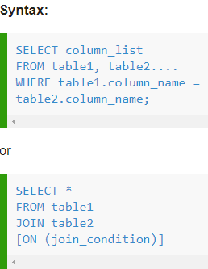
Basic Retrieval Queries in SQL
The SELECT-FROM-WHERE Structure of Basic SQL Queries
SQL EQUI JOIN performs a JOIN against equality or matching column(s) values of the associated tables.
An equal sign (=) is used as comparison operator in the where clause to refer equality.

Slide 25
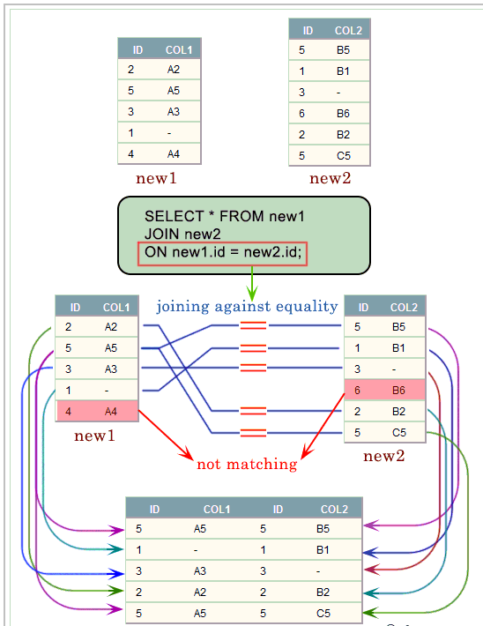
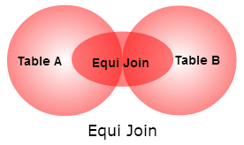
Basic Retrieval Queries in SQL
EQUIJOIN

Slide 26
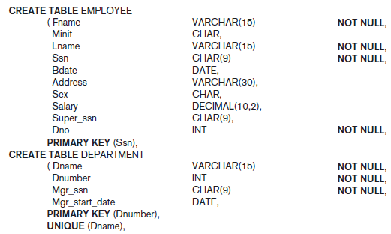
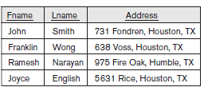
Basic Retrieval Queries in SQL
The SELECT-FROM-WHERE Structure of Basic SQL Queries
Query 1. Retrieve the name and address of all employees who work for the ‘Research’ department.
Q1: SELECT Fname, Lname, Address
FROM EMPLOYEE, DEPARTMENT
WHERE Dname = ‘Research’ AND Dnumber = Dno;
In the WHERE clause of Q1, the condition Dname = ‘Research’ is a selection condition that chooses the particular tuple of interest in the DEPARTMENT table, because Dname is an attribute of DEPARTMENT.
The condition Dnumber = Dno is called a join condition, because it combines two tuples: one from DEPARTMENT and one from EMPLOYEE, whenever the value of Dnumber in DEPARTMENT is equal to the value of Dno.
SELECT clause -> projection operation
It’s a select-project-join query

Slide 27
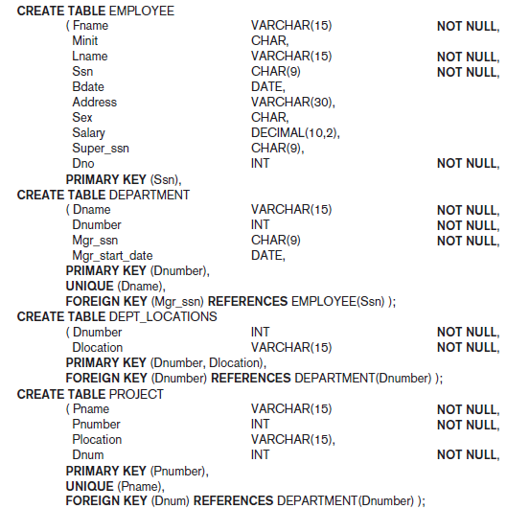

Basic Retrieval Queries in SQL
The SELECT-FROM-WHERE Structure of Basic SQL Queries
Query 2. For every project located in ‘Stafford’, list the project number, the controlling department number, and the department manager’s last name, address, and birth date.
Q2: SELECT Pnumber, Dnum, Lname, Address, Bdate
FROM PROJECT, DEPARTMENT, EMPLOYEE
WHERE Dnum = Dnumber AND Mgr_ssn = Ssn AND
Plocation = ‘Stafford’
The join condition Dnum = Dnumber relates a project tuple to its controlling department tuple, whereas the join condition Mgr_ssn = Ssn relates the controlling department tuple to the employee tuple who manages that department.
Each tuple in the result will be a combination of one project, one department (that controls the project), and one employee (that manages the department).

Slide 28
Basic Retrieval Queries in SQL
Ambiguous Attribute Names, Aliasing, Renaming, and Tuple Variables
In SQL, the same name can be used for two (or more) attributes as long as the attributes are in different tables.
If this is the case, and a multi table query refers to two or more attributes with the same name, we must use the attribute name with the relation name to prevent ambiguity.
This is done by prefixing the relation name to the attribute name and separating the two by a period. Like employee.ID or Department.ID

Slide 29
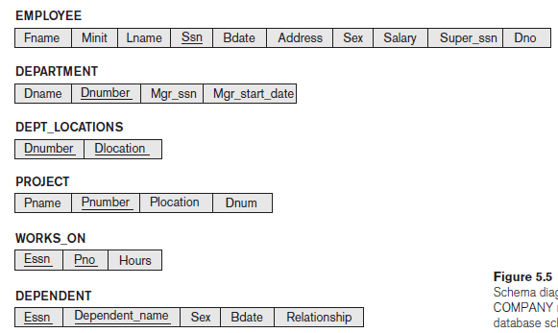


Basic Retrieval Queries in SQL
Ambiguous Attribute Names, Aliasing, Renaming, and Tuple Variables
To illustrate this, suppose that the Dno and Lname attributes of the EMPLOYEE relation were called Dnumber and Name, and the Dname attribute of DEPARTMENT was also called Name; then, to prevent ambiguity, query Q1 would be rephrased as shown in Q1A.
We must prefix the attributes Name and Dnumber in Q1A to specify which ones we are referring to, because the same attribute names are used in both relations:
Query 1. Retrieve the name and address of all employees who work for the ‘Research’ department.
Q1A: SELECT Fname, EMPLOYEE.Name, Address
FROM EMPLOYEE, DEPARTMENT
WHERE DEPARTMENT.Name = ‘Research’ AND
DEPARTMENT.Dnumber = EMPLOYEE.Dnumber;

Slide 30

Basic Retrieval Queries in SQL
Ambiguous Attribute Names, Aliasing, Renaming, and Tuple Variables
A self join is a join in which a table is joined with itself (which is also called Unary relationships), especially when the table has a FOREIGN KEY which references its own PRIMARY KEY.
To join a table itself means that each row of the table is combined with itself and with every other row of the table.
The syntax of the command for joining a table to itself is almost same as that for joining two different tables.
To distinguish the column names from one another, aliases for the actual the table name are used, since both the tables have the same name.
Table name aliases are defined in the FROM clause of the SELECT statement.

Slide 31
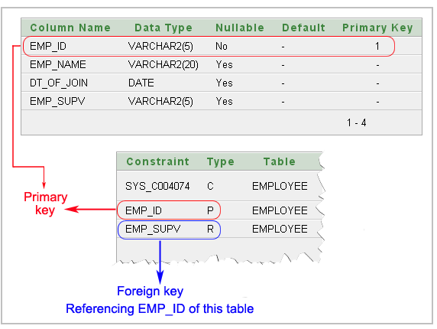
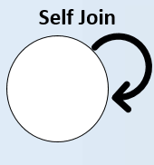
Basic Retrieval Queries in SQL
SELF JOIN

Slide 32

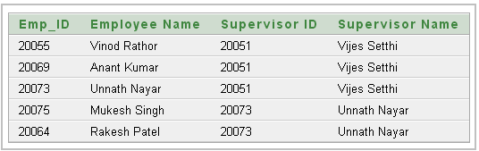
Basic Retrieval Queries in SQL
SELF JOIN

Slide 33
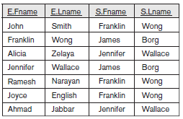
Basic Retrieval Queries in SQL
Ambiguous Attribute Names, Aliasing, Renaming, and Tuple Variables
We can also rename the table names to shorter names by creating an alias for each table name to avoid repeated typing of long table names.
Query 8. For each employee, retrieve the employee’s first and last name and the first and last name of his or her immediate supervisor.
Q8: SELECT E.Fname, E.Lname, S.Fname, S.Lname
FROM EMPLOYEE AS E, EMPLOYEE AS S
WHERE E.Super_ssn = S.Ssn;
It is also possible to rename the relation attributes within the query in SQL by giving them aliases.
For example, if we write EMPLOYEE AS E(Fn, Mi, Ln, Ssn, Bd, Addr, Sex, Sal, Sssn, Dno) in the FROM clause, Fn becomes an alias for Fname, Mi for Minit, Ln for Lname, and so on.

Slide 34
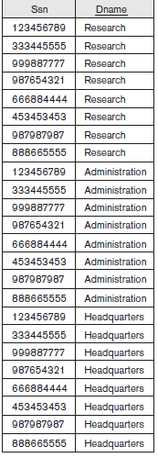
Basic Retrieval Queries in SQL
Unspecified WHERE Clause and Use of the Asterisk
A missing WHERE clause indicates no condition on tuple selection; hence, all tuples of the relation specified in the FROM clause qualify and are selected for the query result.
If more than one relation is specified in the FROM clause and there is no WHERE clause, then the CROSS PRODUCT—all possible tuple combinations—of these relations is selected.
Queries 9 and 10. Select all EMPLOYEE Ssns (Q9) and all combinations of EMPLOYEE Ssn and DEPARTMENT Dname (Q10) in the database.
Q9: SELECT Ssn FROM EMPLOYEE;
Q10: SELECT Ssn, Dname FROM EMPLOYEE, DEPARTMENT;

Slide 35
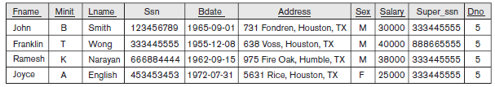
Basic Retrieval Queries in SQL
Unspecified WHERE Clause and Use of the Asterisk
To retrieve all the attribute values of the selected tuples, we do not have to list the attribute names explicitly in SQL; we just specify an asterisk (*), which stands for all the attributes.
Query Q1C retrieves all the attribute values of any EMPLOYEE who works in DEPARTMENT number 5 (Figure 6.3(g)), query Q1D retrieves all the attributes of an EMPLOYEE and the attributes of the DEPARTMENT in which he or she works for every employee of the ‘Research’ department, and Q10A specifies the CROSS PRODUCT of the EMPLOYEE and DEPARTMENT relations.
Q1C: SELECT *
FROM EMPLOYEE
WHERE Dno = 5;
Q1D: SELECT *
FROM EMPLOYEE, DEPARTMENT
WHERE Dname = ‘Research’ AND Dno = Dnumber;
Q10A: SELECT *
FROM EMPLOYEE, DEPARTMENT;

Slide 36
Basic Retrieval Queries in SQL
Tables as Sets in SQL
SQL usually treats a table not as a set but rather as a multiset;
duplicate tuples can appear more than once in a table, and in the result of a query.
An SQL table with a key is restricted to being a set, since the key value must be distinct in each tuple.
If we do want to eliminate duplicate tuples from the result of an SQL query, we use the keyword DISTINCT in the SELECT clause, meaning that only distinct tuples should remain in the result.

Slide 37
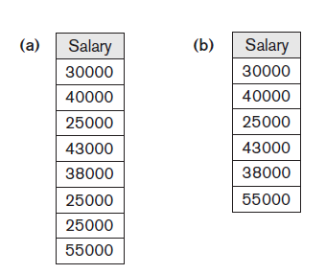
Basic Retrieval Queries in SQL
Tables as Sets in SQL
Query 11. Retrieve the salary of every employee (Q11) and all distinct salary values (Q11A).
Q11: SELECT ALL Salary FROM EMPLOYEE;
Q11A: SELECT DISTINCT Salary FROM EMPLOYEE;

Slide 38
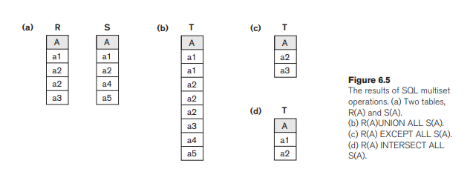
Tables as Sets in SQL
Set operations
UNION, EXCEPT (difference), INTERSECT
Type compatibility is needed for these operations to be valid
Column order matters
Notes:
SQL has directly incorporated some of the set operations from mathematical set theory, which are also part of relational algebra (see Chapter 8). There are set union (UNION), set difference (EXCEPT),11 and set intersection (INTERSECT) operations. The relations resulting from these set operations are sets of tuples; that is, duplicate tuples are eliminated from the result. These set operations apply only to typecompatible relations, so we must make sure that the two relations on which we apply the operation have the same attributes and that the attributes appear in the same order in both relations. The next example illustrates the use of UNION.

Slide 39
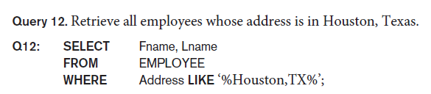
Substring Pattern Matching
LIKE comparison operator: string pattern matching
Partial strings are specified using two reserved characters:
% replaces an arbitrary number of zero or more characters
underscore (_) replaces a single character.
Examples:
Notes:
% wildcard characte

Slide 40
Some Other Examples
LIKE Operator | Description
LIKE 'a%' | Finds any values that start with "a"
LIKE '%a' | Finds any values that end with "a"
LIKE '%or%' | Finds any values that have "or" in any position
LIKE '_r%' | Finds any values that have "r" in the second position
LIKE 'a_%' | Finds any values that start with "a" and are at least 2 characters in length
LIKE 'a__%' | Finds any values that start with "a" and are at least 3 characters in length
LIKE 'a%o' | Finds any values that start with "a" and ends with "o"

Slide 41
Substring Pattern Matching
Query 12A. Find all employees who were born during the 1950s.
Q12: SELECT Fname, Lname
FROM EMPLOYEE
WHERE Bdate LIKE ‘_ _ 5 _ _ _ _ _ _ _’;
Notes:
If an underscore or % is needed as a literal character in the string, the character should be preceded by an escape character, which is specified after the string using the keyword ESCAPE. For example, ‘AB\_CD\%EF’ ESCAPE ‘\’ represents the literal string ‘AB_CD%EF’ because \ is specified as the escape character. Any character not used in the string can be chosen as the escape character. Also, we need a rule to specify apostrophes or single quotation marks (‘ ’) if they are to be included in a string because they are used to begin and end strings. If an apostrophe (’) is needed, it is represented as two consecutive apostrophes (”) so that it will not be interpreted as ending the string. Notice that substring comparison implies that attribute values are not atomic (indivisible) values, as we had assumed in the formal relational model

Slide 42
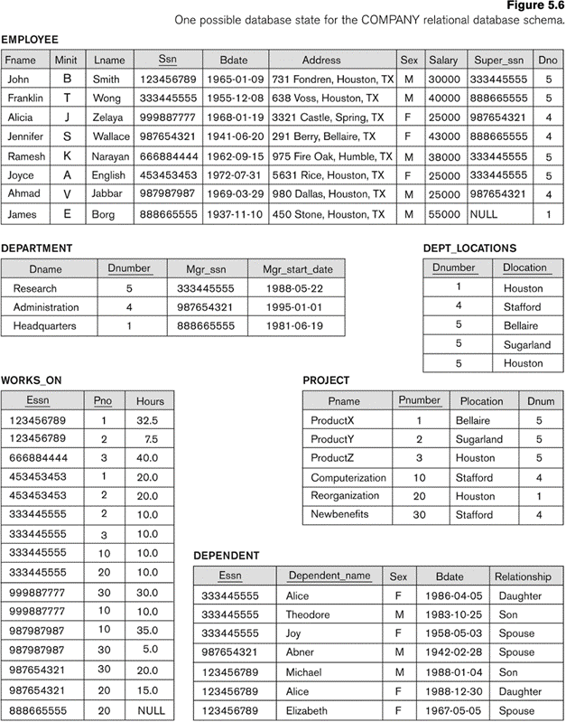
SQL Arithmetic Operators
Operator | Description
+ | Add
- | Subtract
* | Multiply
/ | Divide
% | Modulo
Query 13. Show the resulting salaries if every employee working on the
‘ProductX’ project is given a 10% raise.
SELECT E.Fname, E.Lname, 1.1 * E.Salary
AS Increased_sal
FROM EMPLOYEE E, WORKS_ON W, PROJECT P
WHERE E.Ssn = W.Essn AND W.Pno = P.Pnumber
AND P.Pname = ‘ProductX’;

Slide 43
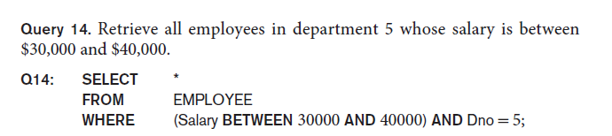
Comparison Operator: Between
BETWEEN: TRUE if the operand is within the range of comparisons
The condition (Salary BETWEEN 30000 AND 40000) in Q14 is equivalent to the condition ((Salary >= 30000) AND (Salary <= 40000)).

Slide 44
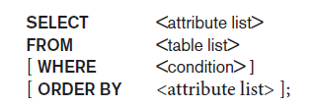
Ordering of Query Results
ORDER BY : order the tuples in the result of a query by the values of one or more of the attributes that appear in the query result.
Syntax:

Slide 45
Sample Database
CustomerID | CustomerName | ContactName | Address | City | PostalCode | Country
1 | Alfreds Futterkiste | Maria Anders | Obere Str. 57 | Berlin | 12209 | Germany
2 | Ana Trujillo Emparedados y helados | Ana Trujillo | Avda. de la Constitución 2222 | México D.F. | 05021 | Mexico
3 | Antonio Moreno Taquería | Antonio Moreno | Mataderos 2312 | México D.F. | 05023 | Mexico
4 | Around the Horn | Thomas Hardy | 120 Hanover Sq. | London | WA1 1DP | UK
5 | Berglunds snabbköp | Christina Berglund | Berguvsvägen 8 | Luleå | S-958 22 | Sweden
6 | Blauer See Delikatessen | Hanna Moos | Forsterstr. 57 | Mannheim | 68306 | Germany
7 | Blondel père et fils | Frédérique Citeaux | 24, place Kléber | Strasbourg | 67000 | France
8 | Bólido Comidas preparadas | Martín Sommer | C/ Araquil, 67 | Madrid | 28023 | Spain

Slide 46

Ordering of Query Results
CustomerID | CustomerName | ContactName | Address | City | PostalCode | Country
12 | Cactus Comidas para llevar | Patricio Simpson | Cerrito 333 | Buenos Aires | 1010 | Argentina
54 | Océano Atlántico Ltda. | Yvonne Moncada | Ing. Gustavo Moncada 8585 Piso 20-A | Buenos Aires | 1010 | Argentina
64 | Rancho grande | Sergio Gutiérrez | Av. del Libertador 900 | Buenos Aires | 1010 | Argentina
20 | Ernst Handel | Roland Mendel | Kirchgasse 6 | Graz | 8010 | Austria
59 | Piccolo und mehr | Georg Pipps | Geislweg 14 | Salzburg | 5020 | Austria
50 | Maison Dewey | Catherine Dewey | Rue Joseph-Bens 532 | Bruxelles | B-1180 | Belgium
76 | Suprêmes délices | Pascale Cartrain | Boulevard Tirou, 255 | Charleroi | B-6000 | Belgium
15 | Comércio Mineiro | Pedro Afonso | Av. dos Lusíadas, 23 | São Paulo | 05432-043 | Brazil

Slide 47
ORDER BY DESC
SELECT * FROM Customers ORDER BY Country DESC;
CustomerID | CustomerName | ContactName | Address | City | PostalCode | Country
33 | GROSELLA-Restaurante | Manuel Pereira | 5ª Ave. Los Palos Grandes | Caracas | 1081 | Venezuela
35 | HILARIÓN-Abastos | Carlos Hernández | Carrera 22 con Ave. Carlos Soublette #8-35 | San Cristóbal | 5022 | Venezuela
46 | LILA-Supermercado | Carlos González | Carrera 52 con Ave. Bolívar #65-98 Llano Largo | Barquisimeto | 3508 | Venezuela
47 | LINO-Delicateses | Felipe Izquierdo | Ave. 5 de Mayo Porlamar | I. de Margarita | 4980 | Venezuela
32 | Great Lakes Food Market | Howard Snyder | 2732 Baker Blvd. | Eugene | 97403 | USA
36 | Hungry Coyote Import Store | Yoshi Latimer | City Center Plaza 516 Main St. | Elgin | 97827 | USA
43 | Lazy K Kountry Store | John Steel | 12 Orchestra Terrace | Walla Walla | 99362 | USA
45 | Let's Stop N Shop | Jaime Yorres | 87 Polk St. Suite 5 | San Francisco | 94117 | USA
48 | Lonesome Pine Restaurant | Fran Wilson | 89 Chiaroscuro Rd. | Portland | 97219 | USA
55 | Old World Delicatessen | Rene Phillips | 2743 Bering St. | Anchorage | 99508 | USA

Slide 48
INSERT, DELETE, and UPDATE Statements in SQL
INSERT: used to add a single tuple (row) to a relation (table).
INSERT INTO Syntax:
1. INSERT INTO table_name (col1,col2,col3,……)VALUES (value1, value2, value3, ...);
2. INSERT INTO table_name VALUES (value1, value2, value3, ...);
Notes:
We must specify the relation name and a list of values for the tuple. The values should be listed in the same order in which the corresponding attributes were specified in the CREATE TABLE command.

Slide 49
Demo Database
Customer ID | CustomerName | ContactName | Address | City | PostalCode | Country
89 | White Clover Markets | Karl Jablonski | 305 - 14th Ave. S. Suite 3B | Seattle | 98128 | USA
90 | Wilman Kala | Matti Karttunen | Keskuskatu 45 | Helsinki | 21240 | Finland
91 | Wolski | Zbyszek | ul. Filtrowa 68 | Walla | 01-012 | Poland
INSERT INTO Customers (CustomerName, ContactName, Address, City, PostalCode, Country)
VALUES ('Cardinal', 'Tom B. Erichsen', 'Skagen 21', 'Stavanger', '4006', 'Norway');

Slide 50
Query Result
CustomerID | Customer Name | Contact Name | Address | City | PostalCode | Country
89 | White Clover Markets | Karl Jablonski | 305 - 14th Ave. S. Suite 3B | Seattle | 98128 | USA
90 | Wilman Kala | Matti Karttunen | Keskuskatu 45 | Helsinki | 21240 | Finland
91 | Wolski | Zbyszek | ul. Filtrowa 68 | Walla | 01-012 | Poland
92 | Cardinal | Tom B. Erichsen | Skagen 21 | Stavanger | 4006 | Norway

Slide 51
SQL INSERT INTO SELECT Statement
INSERT INTO SELECT
copies data from one table and inserts it into another table.
requires that the data types in source and target tables matches.
Copy all columns from one table to another table:
INSERT INTO table2
SELECT * FROM table1
WHERE condition;
Copy only some columns from one table into another table:
INSERT INTO table2 (column1, column2, column3, ...)
SELECT column1, column2, column3, ...
FROM table1
WHERE condition;

Slide 52
Demo Database
CustomerID | CustomerName | ContactName | Address | City | PostalCode | Country
1 | Alfreds Futterkiste | Maria Anders | Obere Str. 57 | Berlin | 12209 | Germany
2 | Ana Trujillo Emparedados y helados | Ana Trujillo | Avda. de la Constitución 2222 | México D.F. | 05021 | Mexico
3 | Antonio Moreno Taquería | Antonio Moreno | Mataderos 2312 | México D.F. | 05023 | Mexico
Add a selection from the "Suppliers" table:
SupplierID | SupplierName | ContactName | Address | City | Postal Code | Country
1 | Exotic Liquid | Charlotte Cooper | 49 Gilbert St. | Londona | EC1 4SD | UK
2 | New Orleans Cajun Delights | Shelley Burke | P.O. Box 78934 | New Orleans | 70117 | USA
3 | Grandma Kelly's Homestead | Regina Murphy | 707 Oxford Rd. | Ann Arbor | 48104 | USA

Slide 53
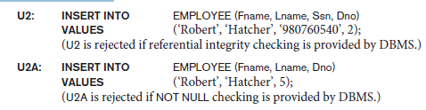
Example
INSERT INTO Customers (CustomerName, City, Country) SELECT SupplierName, City, Country FROM Suppliers;
Example
INSERT INTO Customers (CustomerName, City, Country)
SELECT SupplierName, City, Country FROM Suppliers
WHERE Country='Germany';

Slide 54
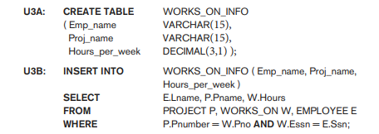
INSERT INTO SELECT

Slide 55
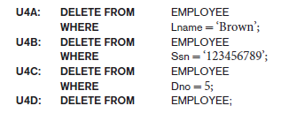
The DELETE Command
DELETE command removes tuples from a relation.
Notes:
The DELETE command removes tuples from a relation. It includes a WHERE clause, similar to that used in an SQL query, to select the tuples to be deleted. Tuples are explicitly deleted from only one table at a time. However, the deletion may propagate to tuples in other relations if referential triggered actions are specified in the referential integrity constraints of the DDL (see Section 6.2.2).12 Depending on the number of tuples selected by the condition in the WHERE clause, zero, one, or several tuples can be deleted by a single DELETE command. A missing WHERE clause specifies that all tuples in the relation are to be deleted; however, the table remains in the database as an empty table. We must use the DROP TABLE command to remove the table definition (see Chapter 7). The DELETE commands in U4A to U4D, if applied independently to the database state shown in Figure 5.6, will delete zero, one, four, and all tuples, respectively, from
the EMPLOYEE relation:

Slide 56

The UPDATE Command
UPDATE command is used to modify attribute values of one or more selected tuples.
Syntax:
UPDATE table_name
SET column1 = value1, column2 = value2, ...
WHERE condition;
Notes:
The UPDATE command is used to modify attribute values of one or more selected tuples. As in the DELETE command, a WHERE clause in the UPDATE command selects the tuples to be modified from a single relation. However, updating a primary key value may propagate to the foreign key values of tuples in other relations if such a referential triggered action is specified in the referential integrity constraints of the DDL (see Section 6.2.2). An additional SET clause in the UPDATE command specifies the attributes to be modified and their new values. For example, to change the location and controlling department number of project number 10 to ‘Bellaire’ and 5, respectively, we use U5:
Update Warning!
Be careful when updating records. If you omit the WHERE clause, ALL records will be updated!
Example
UPDATE Customers
SET ContactName='Juan';

Slide 57
Additional Features of SQL
Various techniques for specifying complex retrieval queries, including nested queries, aggregate functions, grouping, joined tables, outer joins, SQL views, triggers, and assertions; and commands for schema modification such as DROP SCHEMA.
SQL has various techniques for writing programs in various programming languages that include SQL statements to access one or more databases. These include embedded (and dynamic) SQL, SQL/CLI (Call Level Interface) and its predecessor ODBC (Open Data Base Connectivity), and SQL/PSM (Persistent Stored Modules).
Each commercial RDBMS will have, in addition to the SQL commands, a set of commands for specifying physical database design parameters, file structures for relations, and access paths such as indexes known as storage definition language (SDL).
SQL has transaction control commands. These are used to specify units of database processing for concurrency control and recovery purposes.

Slide 58
Additional Features of SQL
SQL has language constructs for specifying the granting and revoking of privileges to users. Each relation is assigned an owner, and either the owner or the DBA staff can grant to selected users the privilege to use an SQL statement—such as SELECT, INSERT, DELETE, or UPDATE. The DBA staff can grant the privileges to create schemas, tables, or views to certain users. These SQL commands—called GRANT and REVOKE.
SQL has language constructs for creating triggers. These are generally referred to as active database techniques, since they specify actions that are automatically triggered by events such as database updates.
SQL has incorporated many features from object-oriented models to have more powerful capabilities, leading to enhanced relational systems known as object-relational.
SQL and relational databases can interact with new technologies such as XML.

